Slide 1




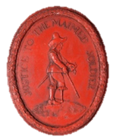
Spies!

Slide 2
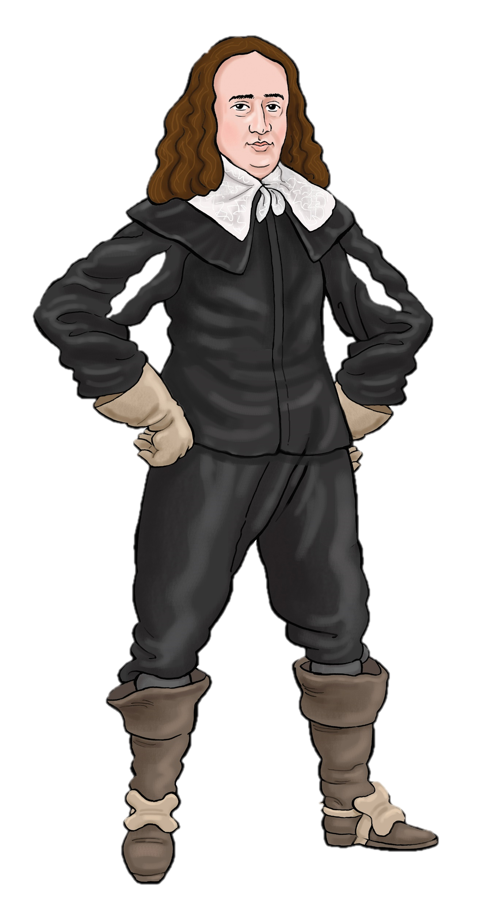

Become a
Parliamentarian Postmaster

Slide 3
I am John Thurloe, Spymaster for
His Highness, Lord Protector, Oliver Cromwell.
The tyrant King Charles is dead.
His son, Charles Stuart, is in France
Royalist supporters are plotting to help
Charles Stuart return and become King.

Slide 4
A group of Royalist spies called The Sealed Knot are plotting to help Charles Stuart become King.
They are sending secret messages through the post.
You are my new postmasters.
I have an important job for you.

Slide 5
Read the letters in this post bag.
Report any letters that look suspicious!
Let’s try and stop the Sealed Knot from bringing back the King!

Slide 6
How to spot spy messages..
We don’t need to worry about letters from women. Women’s letters are always full of boring family news and nonsense! Ignore them!
Don’t bother about ordinary things like shopping and presents.
Keep your eyes peeled for secret codes.
Royalist spies use clever tricks. Watch out!

Slide 7

Think like the Sealed Knot..
The Sealed Knot know we are watching them!
If you were a Royalist spy trying to send a secret message through the post, how might you do it?
What clever tricks could you use?
Think
Pair
Share

Slide 8
Work in 5 groups of postmasters.
1. Read your letter
Who is it from? Who is it to?
What does it seem to be about?
2. Is it suspicious? Why?
3. Present your ideas

Slide 9

Click on the letter you want to open. Find out if it was written by a spy!
Anthony Hinton,
Apothecary shop
19 Crow Street,
London
Nicholas Atkins
22 Brewer Street,
Newark,
Nottinghamshire
Edward Smith
18, Holgate Street,
London
1
2
3
Thomas Hogmay,
4 Market Street,
Colchester,
Essex
Henry Hopwood,
7 Ash Lane,
Alverstoke, Gosport.
Finished opening letters
4
5

Slide 10
Nicholas Atkins
22 Brewer Street,
Newark,
Nottinghamshire

Slide 11

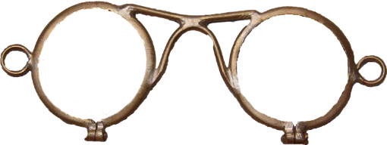
Open another letter
This writer has found a clever way of sending an almost blank sheet of paper through the post.
The spy is pretending to send some glasses for a customer to try on.
Dear Nicholas
Try on these spectacles and let me know if they fit.
Leave the message in the hole in the wall on Thursday next. It will be collected by the gardener.
The real message is written in invisible ink made from lemon or artichoke juice.
You just need to heat the letter with a candle flame and the words will appear..

Slide 12


This has been sent to an apothecary who will pass on the real letter inside
Susan Hyde,
28 Fisher Street,
London
Anthony Hinton,
Apothecary shop
19 Crow Street,
London

Slide 13
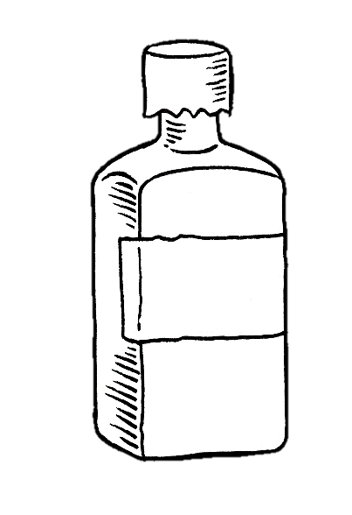
Sweet sister,
We all miss you. We are sending you a token of our love. Our cousins abroad ask for news of you and send you this medicine as you have been so ill. Be sure not to drink it but make sure you rub it both above and below the ribs. When you do so things will seem easier, I am sure. I hope you are well and that this letter reaches you safely. I think perhaps my last letter did not?
I remain, your dearest brother,
Francis Edwards
This ‘brother’ is sending his ‘sister’ a bottle of ’medicine’. Or is he??
The plan is discovered. We are being watched. Do not come to the meeting place. Wait for further instructions. Another letter will be sent from Hinton’s Apothecary Shop on Friday
The medicine is a bottle of silver nitrate. If rubbed over the spaces between the lines it reveals a secret message written in invisible ink. It is very poisonous!
The writer of this letter is Charles Stuart!
Hinton
Rub above and below ribs

Slide 14
Open another letter
Sweet sister,
We all miss you. We are sending you a token of our love. Our cousins abroad ask for news of you and send you this medicine as you have been so ill. Be sure not to drink it but make sure you rub it both above and below the ribs. When you do so things will seem easier, I am sure. I hope you are well and that this letter reaches you safely. I think perhaps my last letter did not?
I remain, your dearest brother,
Francis Edwards
This letter was send inside a false envelope addressed to Nicholas Hinton, a chemist (apothecary).
Doctors, nurses and apothecaries could easily move from house to house so made excellent spies.
The apothecary, Nicholas Hinton, is receiving letters for Susan Hyde, one of the Sealed Knot!
The plan is discovered. We are being watched. Do not come to the meeting place. Wait for further instructions. Another letter will be sent from Hinton’s Apothecary Shop on Friday

Slide 15
Edward Smith
18, Holgate Street,
London

Slide 16
Open another letter
My dearest love,
I can hardly wait to see you again. The hours without you seem so long. I look at your portrait every day, but it is not the same as seeing your sweet face. Father sends his love. He is well but becoming rather deaf. Yesterday Jane Marcham called at the door with a tray of fish and eggs. He thought she was trying to sell him fish legs! He shouted “I might be old but I still have the sense I was born with!” We bought 2 fish and 6 eggs and showed them to him but he still mutters about being taken advantage of in his old age. It is only 3 days until we meet again and yet it feels like forever. I will meet you under the oak tree by the river at noon.
Your devoted friend
This spy is pretending to be a woman writing family gossip.
We bought 2 fish and 6 eggs and showed them to him but he still mutters about being taken advantage of in his old age. It is only 3 days until we meet again and yet it feels like forever.
I will meet you under the oak tree by the river at noon.
Really they are telling another spy to meet them on the 26th day of the month by the oak tree at 12 o’clock!
Bridget Lane

Slide 17
Thomas Hogmay,
4 Market Street,
Colchester,
Essex

Slide 18
Open another letter
Spies pretended to be ordering goods from shops to hide their secret messages. This letter is from a member of the Sealed Knot!
Dear Sir,
I would like to order some more goods from your shop.
I understand that you need to move your shop this week. I will wait for delivery of the goods after you have a new address.
Send word of this new delivery with the usual order of artichokes.
Your sincerely,
Humphrey Carter
He is warning another spy that his location has been discovered!
He is suggesting that the spy writes to him in invisible ink made of artichoke juice!

Slide 19
Henry Hopwood,
7 Ash Lane,
Alverstoke, Gosport.

Slide 20

Some words in this letter are written in code.
The writer has used a heterogram as a cipher.
A heterogram is a word that does not repeat any letters.
This spy has used a 13 letter heterogram:
Troublemaking
Dear Uncle Henry,
I hope you are well. Yqk tcxy
We miss you and look forward to seeing you on 23rd April. Mother is baking your favourite fruit cake.
Muvt xddviyz tfdpmsfhpu
Lots of love ,
Margaret
409

Slide 21

13 letters is exactly half the alphabet. If the spy puts the other 13 letters under the heterogram they can make a cipher, or secret code, like this…
t | r | o | u | b | l | e | m | a | k | i | n | g
p | d | f | h | j | c | q | s | x | w | v | y | z
z
If the spy wants to write p they write t. What will they write instead of g?

Slide 22

Open another letter
Dear Uncle Henry,
I hope you are well. Yqk tcxy
We miss you and look forward to seeing you on 23rd April. Mother is baking your favourite fruit cake.
Muvt xddviyz tfdpmsfhpu
Lots of love ,
Margaret
409
t | r | o | u | b | l | e | m | a | k | i | n | g
p | d | f | h | j | c | q | s | x | w | v | y | z
New Plan
Ship arrives Portsmouth
Can you decode this message now??

Slide 23
Good work!
Thanks to you we have discovered how The Sealed Knot spies are sneaking messages to one another.
Can you remember their favourite clever tricks?

Slide 24

We might have expected them to use secret codes but ..
Pretending to be women!
Hiding their messages in fake family news!
Pretending to be ordering from shops!
…who would have thought of that!
We will keep our eyes open in future. Thanks to you, they won’t fool us again!

